Slide 1
Nippon Express
Belgium
2022
Company overview
Strategic setting in Genk
Business case

Slide 2
Section 1
NEX GROUP Company Overview

Slide 3


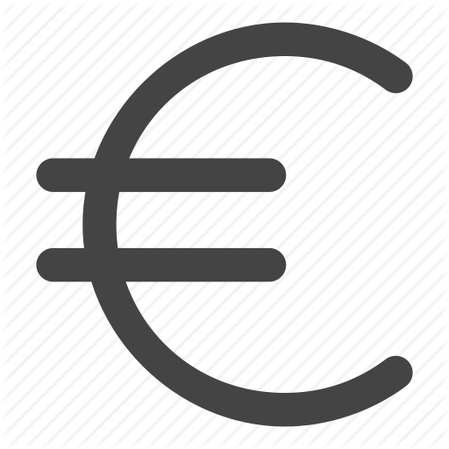
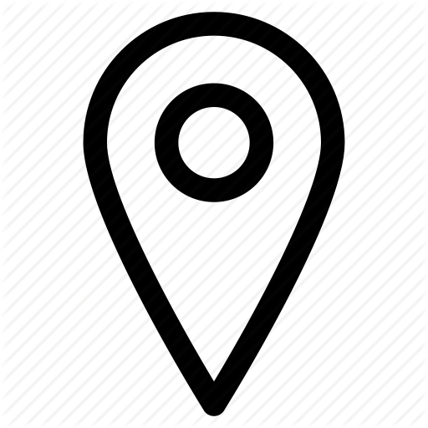


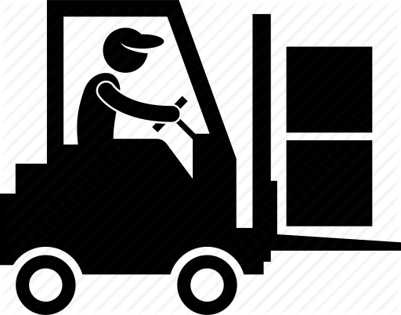
Nippon Express Group in a nutshell
Since 1937
Nippon Express is a Japan-based logistics company with a global reputation. We began working as a logistics provider more than 80 years ago, and our ground transportation business dates back to 1872.
Revenue
15,981 EUR million /
¥ 2,079.195 million
Employees
72.366 employees
Locations
733 locations,
47 countries,
314 cities (overseas)
Warehouse space
6,97 million m2 warehouse space
Trust
3rd largest freight forwarder in the world.
Selected as most admired companies by Fortune (logistics industry)
Nippon Express Belgium NV/SA – Copyright 2022. All rights reserved

Slide 4

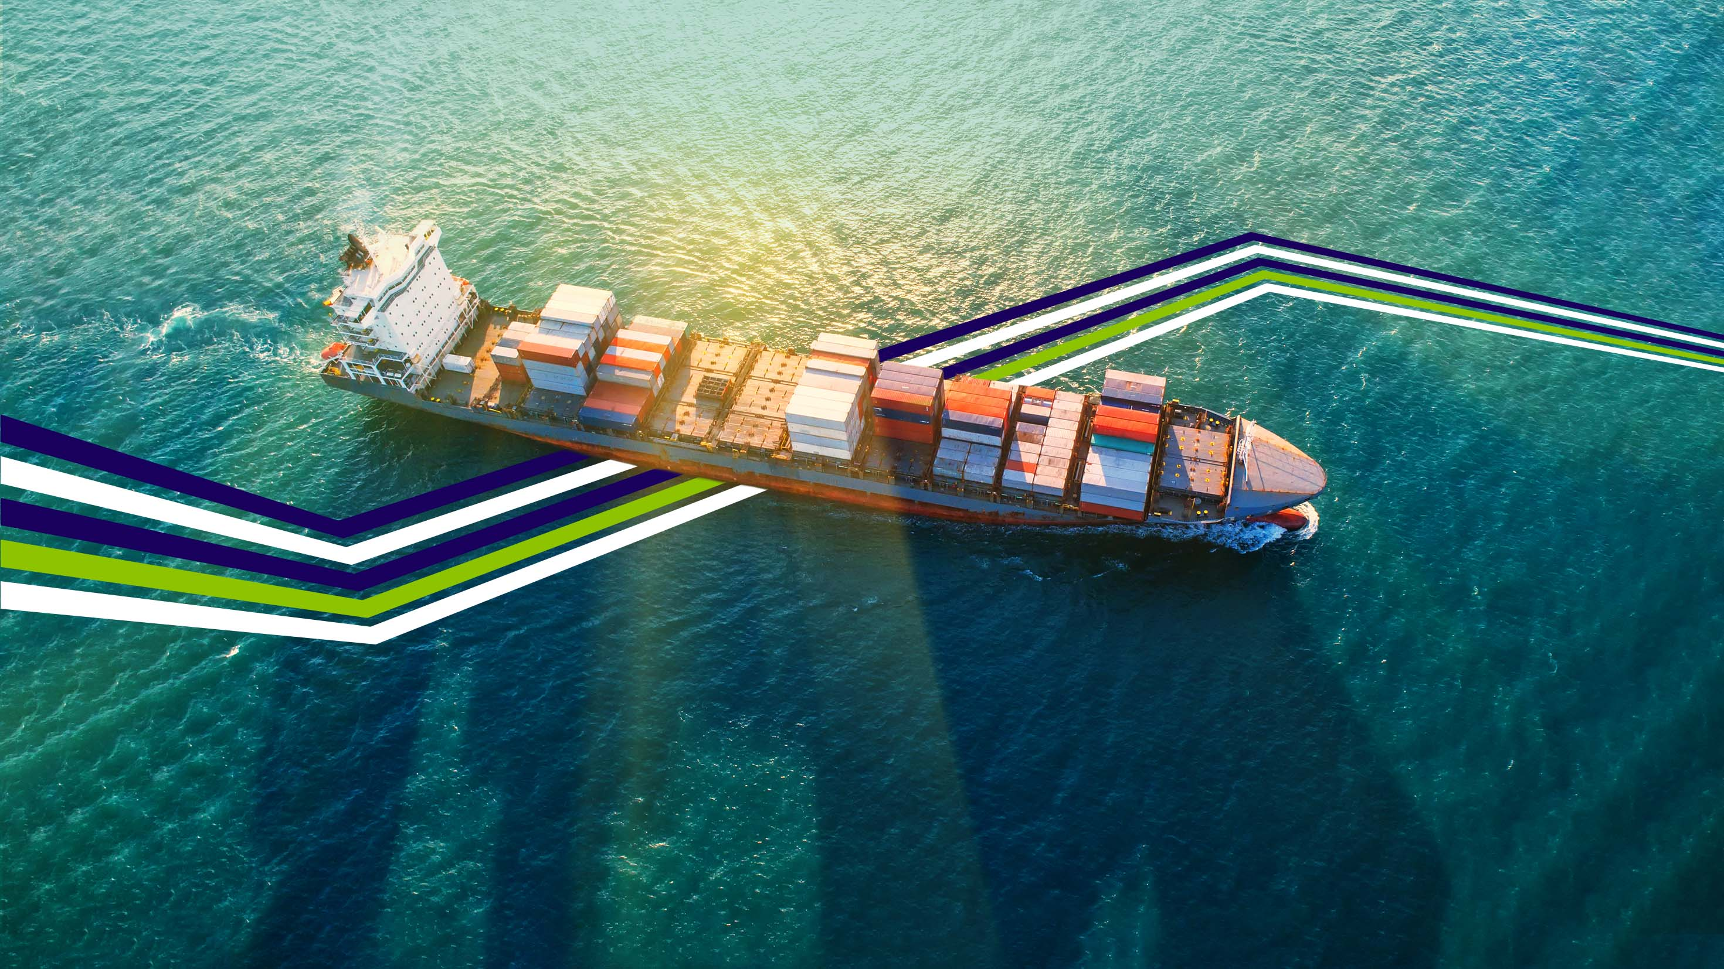
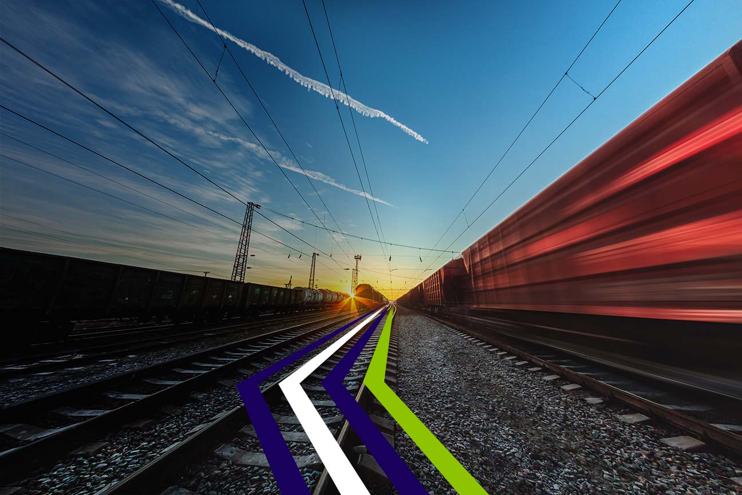
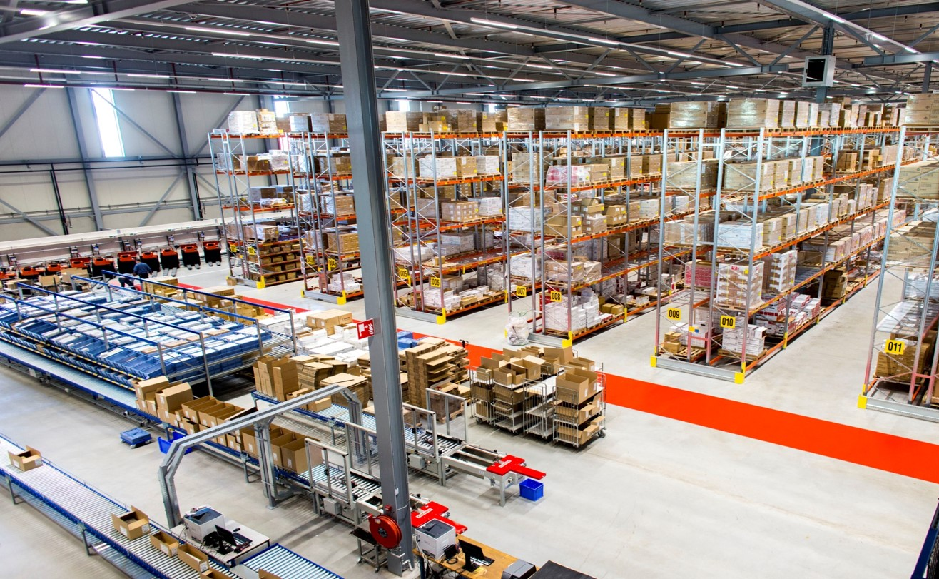
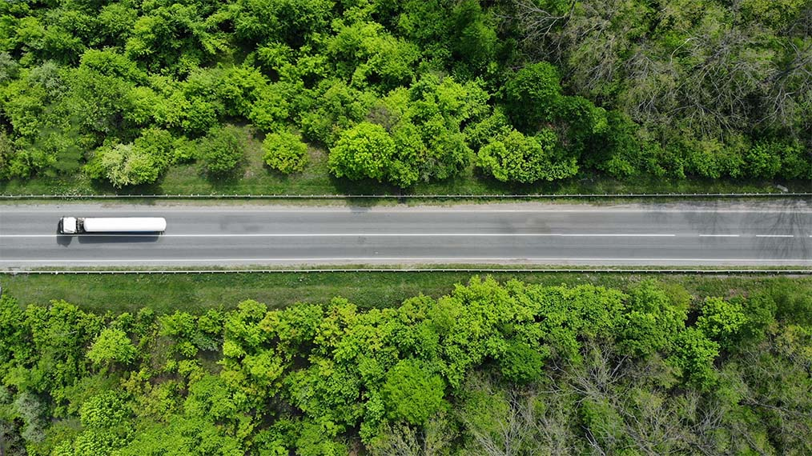
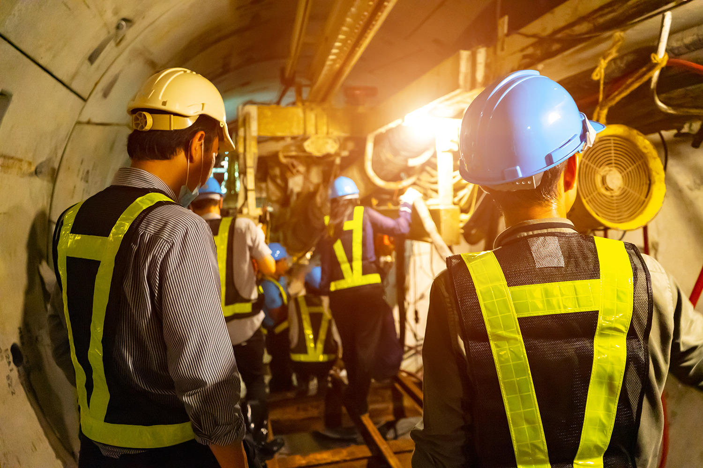

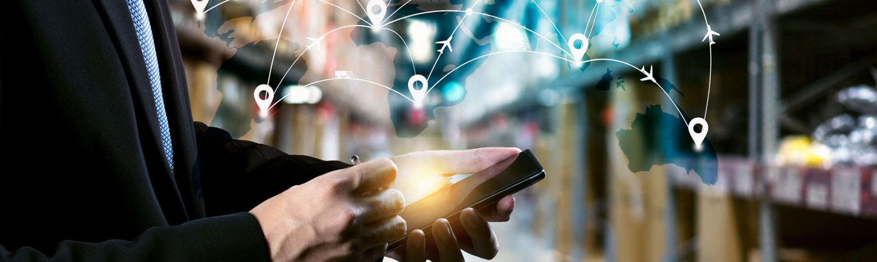
Services
Air Freight
Air freight services with top-quality operations and
a global network.
Ocean Freight
NVOCC,, FCL. LCL
Rail Transportation
Flexible, easily workable railway freight for lower costs, shorter lead times.
Warehouse & Distribution
Our warehouses,
your supply chain.
Road Transportation
International ground freight services optimized for your supply chain.
Heavy Haulage & Construction
Bespoke Services, proven Track Record
Corporate Social Responsibility
Nippon Cares
Application & Systems
Access the various applications and systems that Nippon Express offers.
Nippon Express Belgium NV/SA – Copyright 2022. All rights reserved

Slide 5
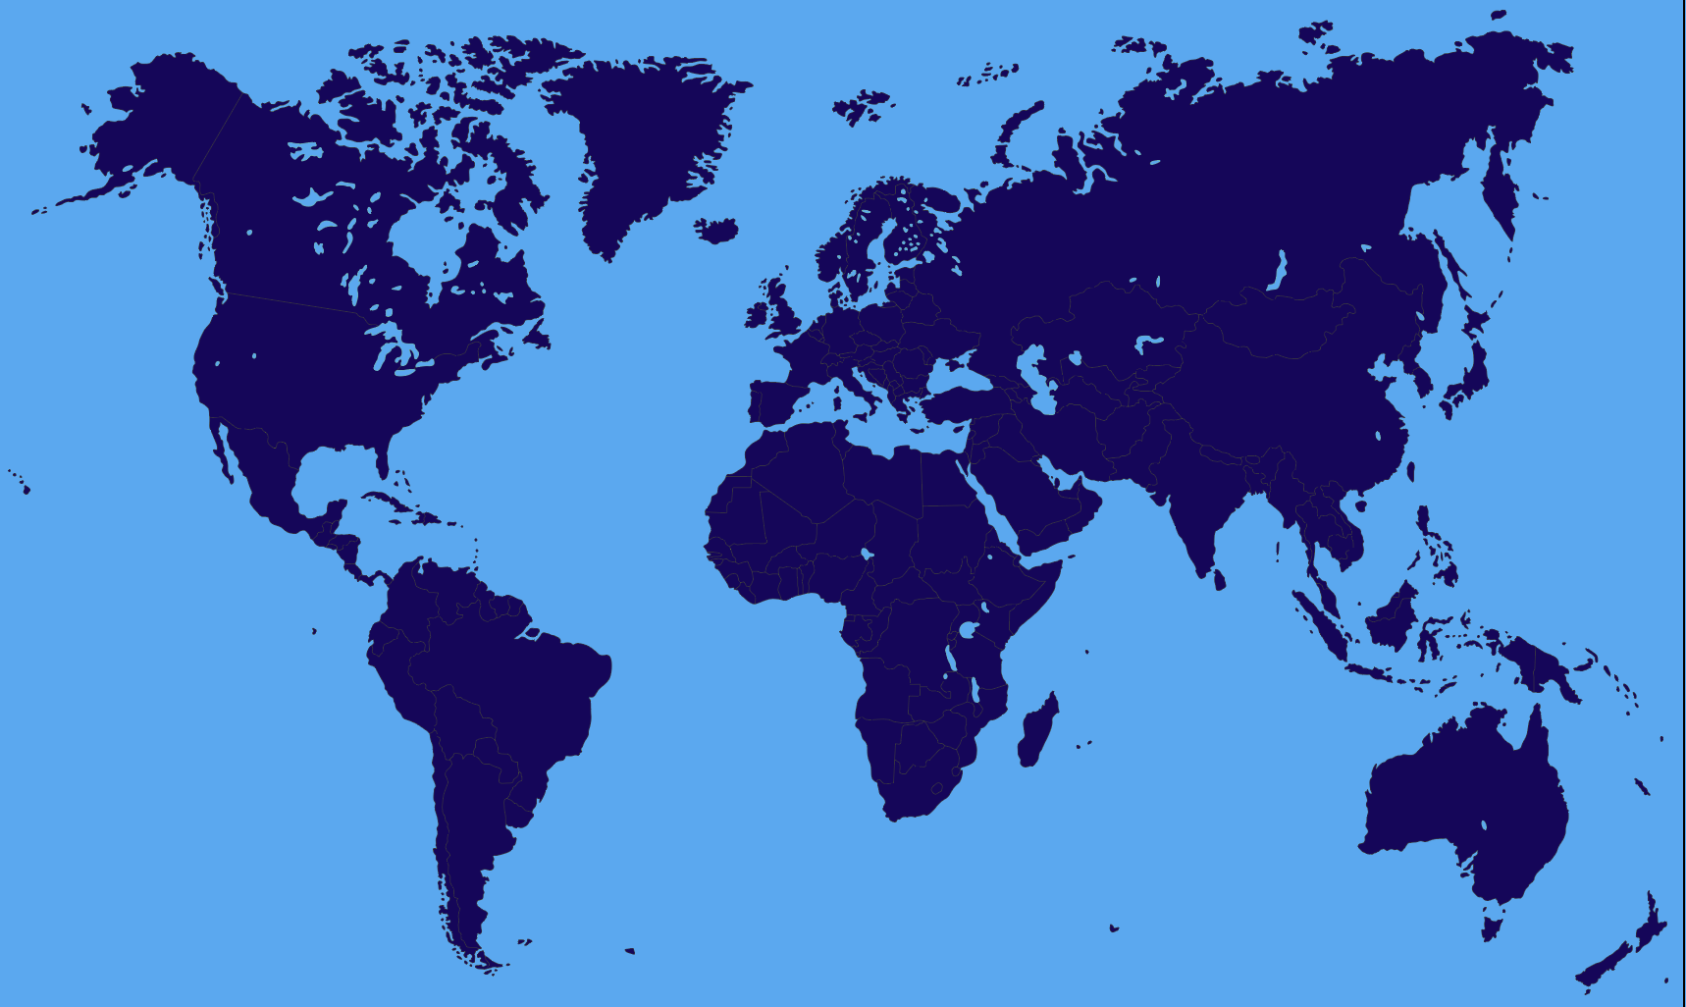
Nippon Express Group – Global Logistic Footprint
EMEA
101 Locations
4,394 Employees
785,428 m2 Wh Space
East Asia
177 Locations
4,658 Employees
677,236 m2 Wh Space
Japan
Locations
42,401 Employees
3,240,542 m2 Wh Space
The Americas
123 Locations
2,866 Employees
718,439 m2 Wh Space
South Asia & Oceania
234 Locations
7,503 Employees
1,140,239 m2 Wh Space
Nippon Express Belgium NV/SA – Copyright 2022. All rights reserved

Slide 6
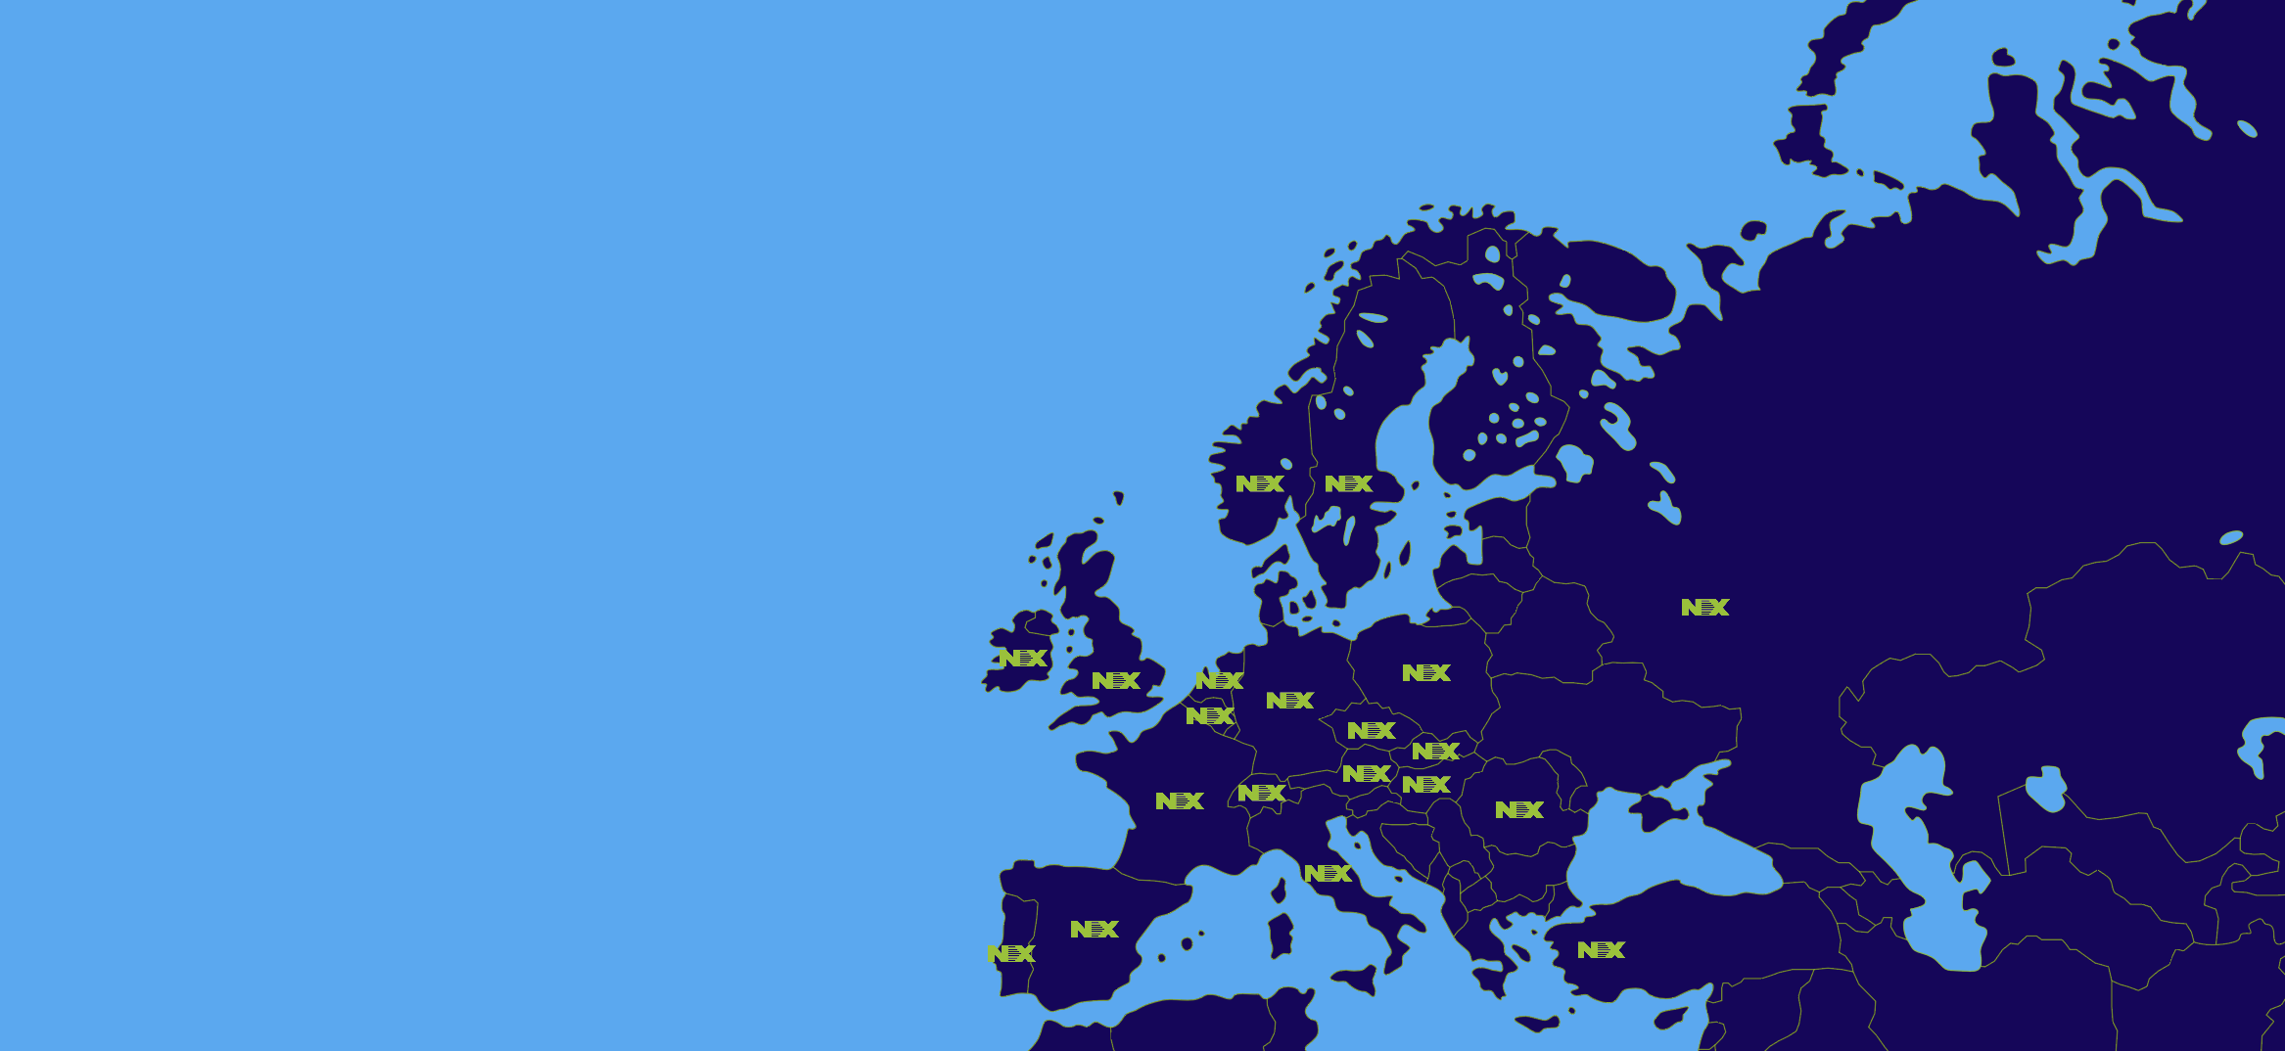
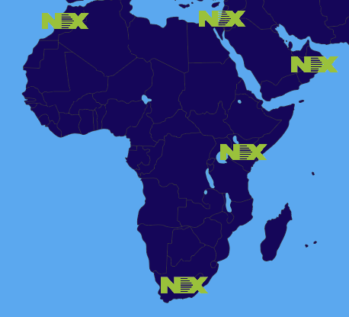
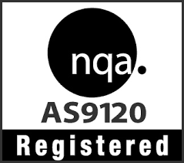
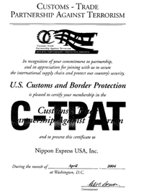
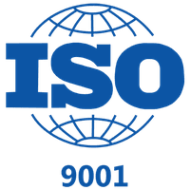
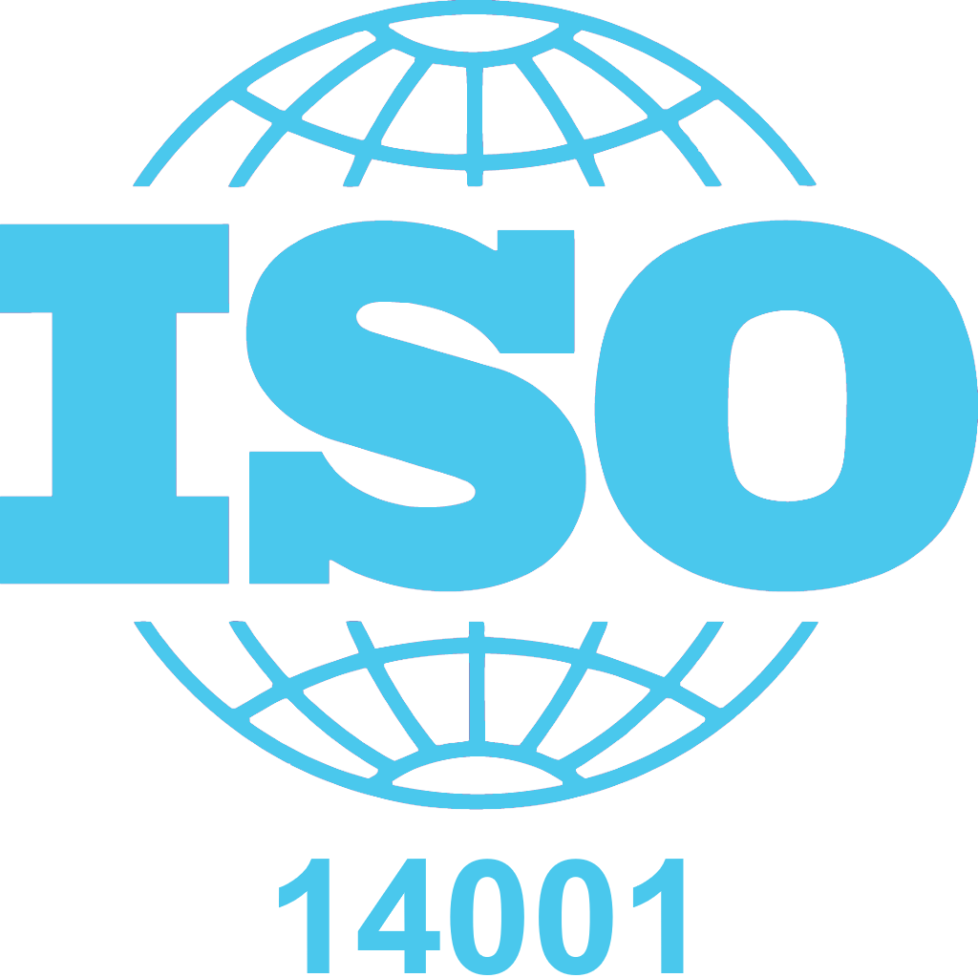


Nippon Express EMEA
Country Footprint
EMEA
101 Locations
4,394 Employees
785,428 m2 Wh Space
3PL / 4PL activities
Solid customs brokerage solutions
All verticals expertise
Local and regional management structure.
Well balanced organisations with a local talent & Embedded Japanese DNA
TAPA CLASS A
AS9120
AEO
C-TPAT
ISO 9001
ISO 14001

Slide 7
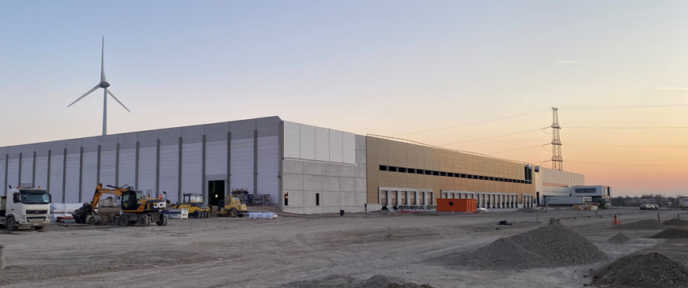
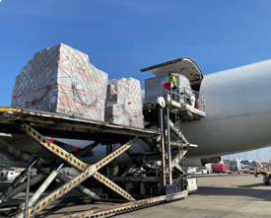
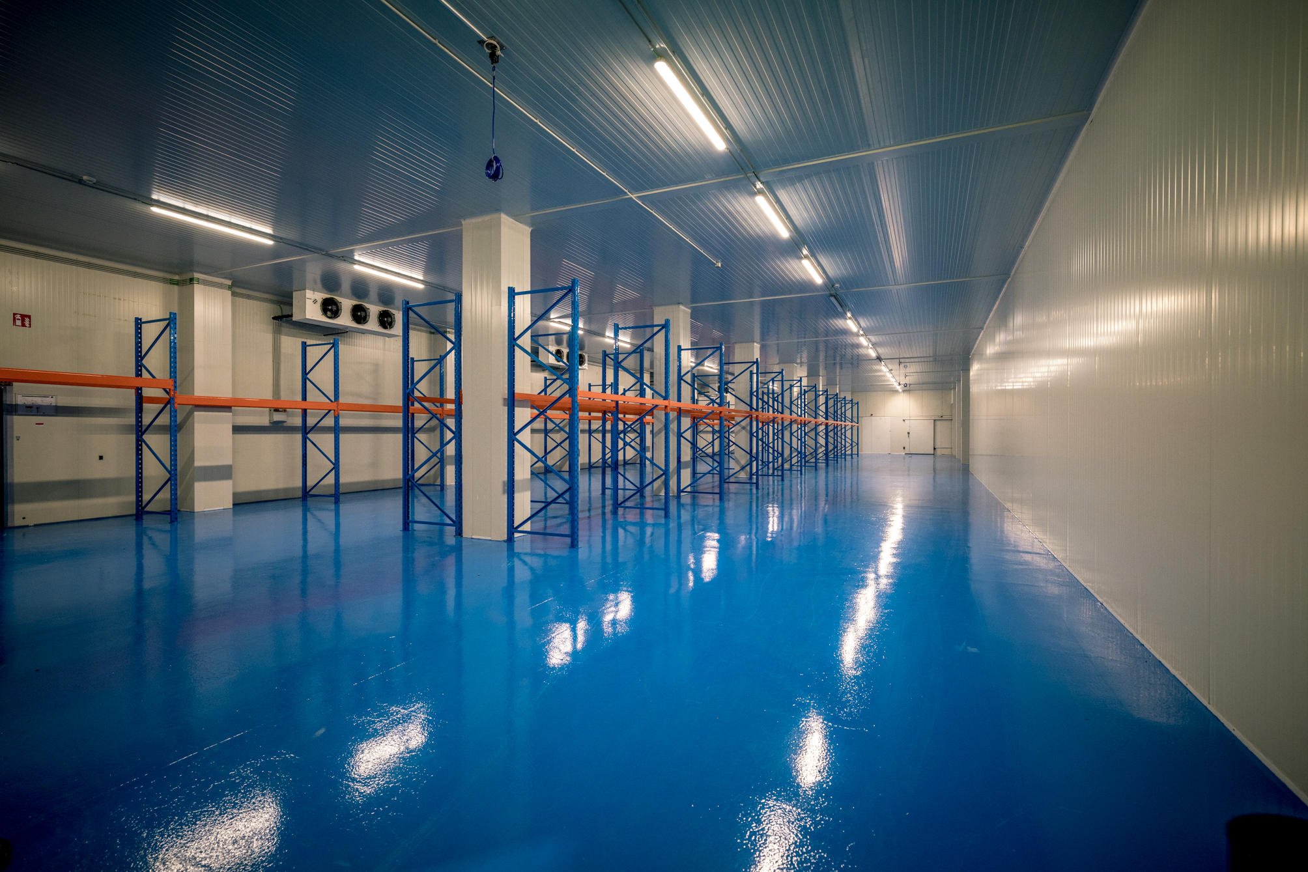
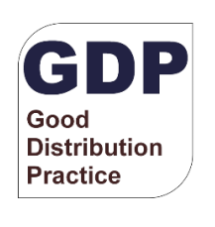
Nippon Express Belgium
Mechelen office
Multi-user whs
5000m²
Pharma options
Decon ocean
Genk Logistics Center
Single user whs
20.000m²
Decon ocean
Options for multi-user
Multimodal consolidation hub
Zaventem HO
Crossdock
7000m²
Airfreight & removal
24/07
Belgian 4th air forwarder
Liege Gateway
Multi-user whs
8000m²
Pharma options
European gateway connection
Charter services
Airport pharma unit
Crossdock
2500m² coolstorage facilities
GDP/GMP
24/07
Frozen storage possible

Slide 8
Section 2
NXB GROUP
Strategic setting in Genk

Slide 9
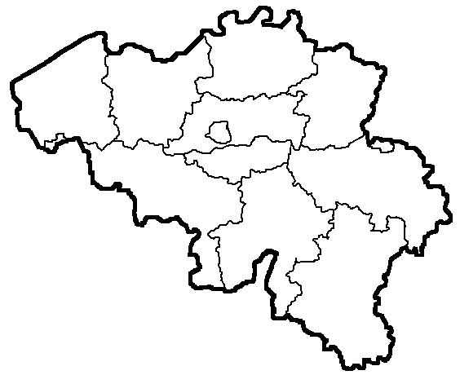

Why Genk -Genk Logistics Center
< Customer Base >
50% of total revenue stream out of Genk Region
Strong vertical development
  Healthcare
  Automotive
NX global accounts
Loyal foundations
Corss Border sales
< GENK : Inland barge terminal >
Divert from Antwerp
Think green – less Co²
Save costs by reducing hualage expense (business case)
Healthy capacity
Proven concept
Connects Antwerp-Rotterdam
< GENK : Greenfield project GGL >
New 250.000 m² greenfield
Connects to largest inland terminal on site
Rail terminal connection
Eco friendly

Slide 10
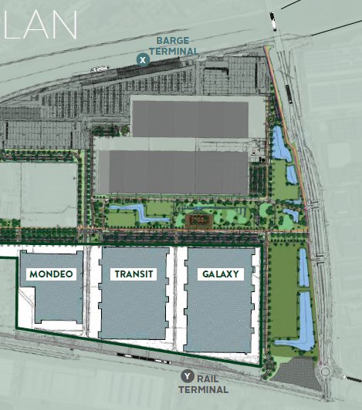
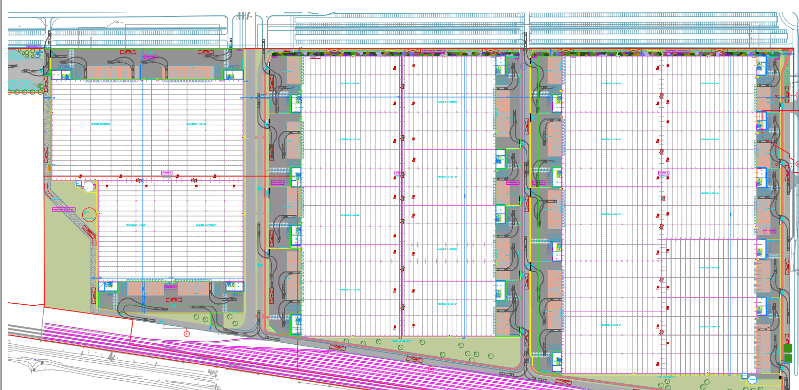
What - Genk Logistics Center – Set-up
A new European deconsolidation center has been obtained by Nippon Express for a large retailer.
Dedicated logistics center (20,000m2 , Apr/2022 )
NXB can possible add another 12,000m2 on top (GLC2023)
Final plan will be to add 2 more units. Final scale : 50,000m2 (GLC 2022,23,24)
NXB also can offer brokerage , intermodal solutions connecting Ocean & Air with this logistics platform
GLC
2024
GLC
2023
GLC
2022

Slide 11
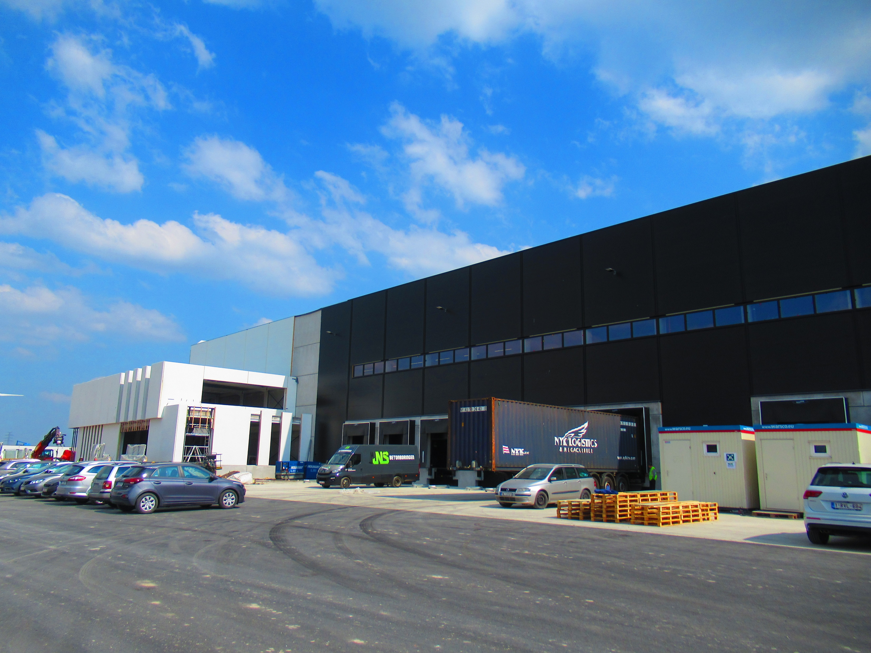
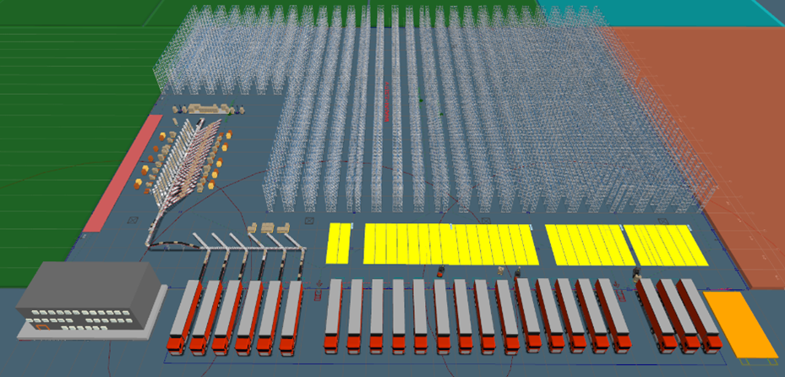
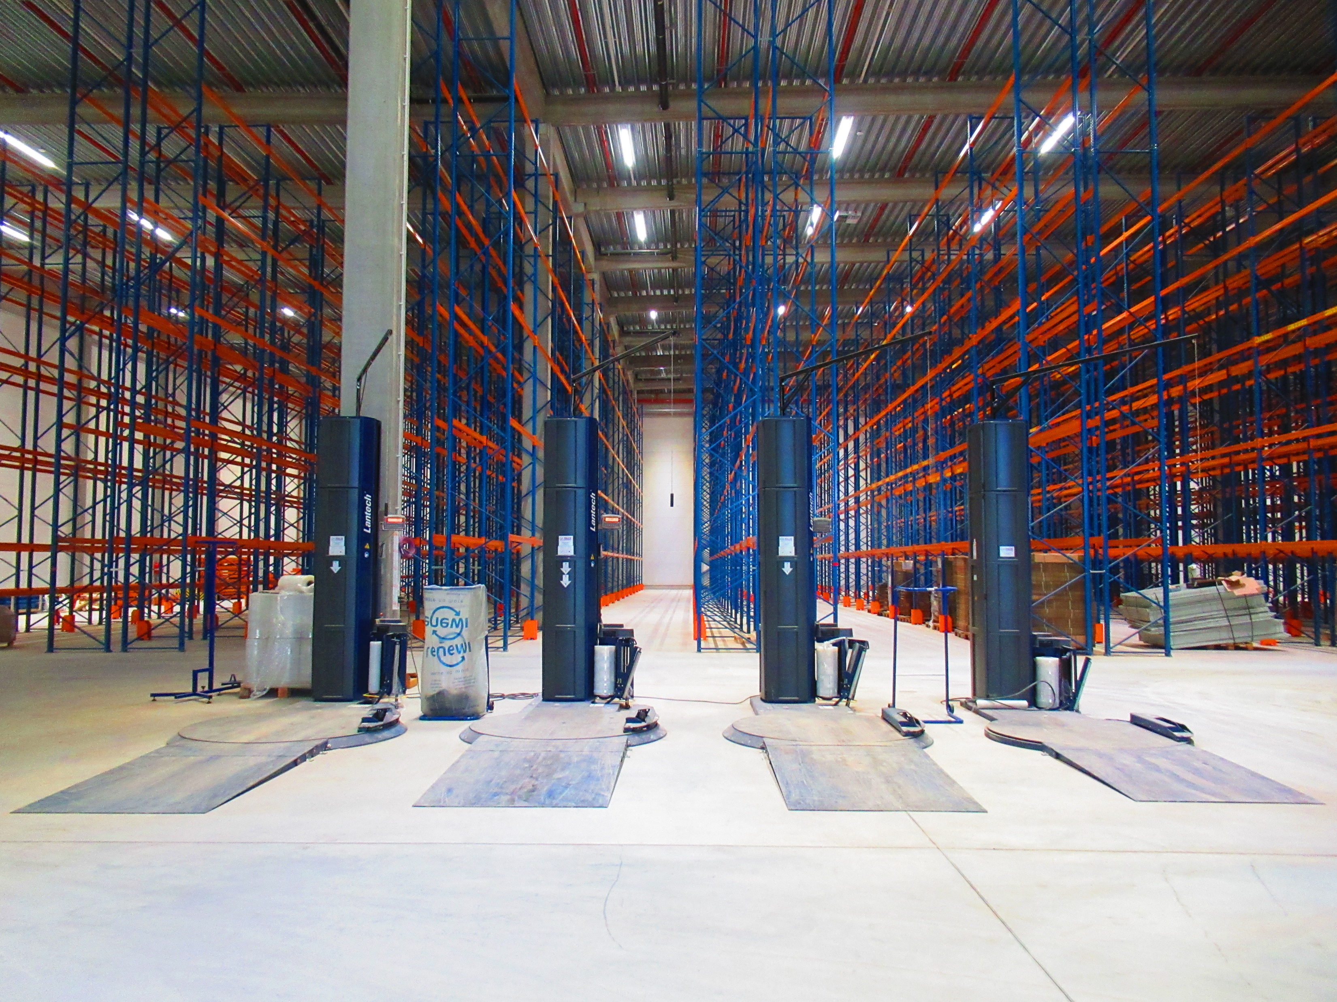
HOW - Genk Logistics Center – Set-up
Focus on sustainability
  Greenfield
  Barging
  Breeam excellent
Focus on efficiency
  Automation
  Operational excellence
Adapt to
  Growing demand
  Multi-functionallity
  Multi-modality
  Connects towards other segments
Focus on customer’s flexibility
  Activities
  Seasonality
  Resources

Slide 12
Section 3
NXB GROUP
Business case

Slide 13
Listing to the customers voice – Challenges in the market
Contingency : Haulage
Contingency :Distance
CO2 Reductions
Cost Control
VAS
Waiting hours
Demurrage – Detention
Trucking costs
Main port congestion
Driver shortage
Availability
Traffic jams F
Flexibillity
Deviate from warehouse for added value
Direct to customer

Slide 14
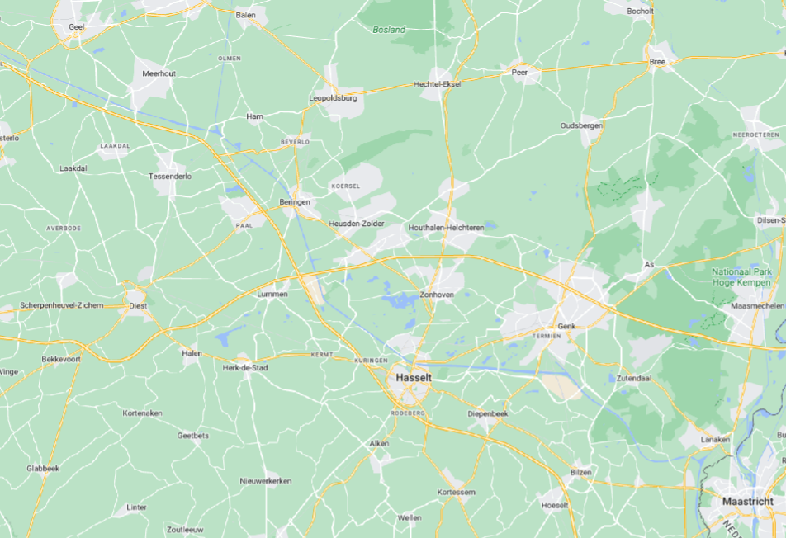
Define the eco-system
customs
Receivers
Shippers
Main Ports
GGL Ecosystem
trucking
Barging
Nippon Branches
End Customers
Airports

Slide 15
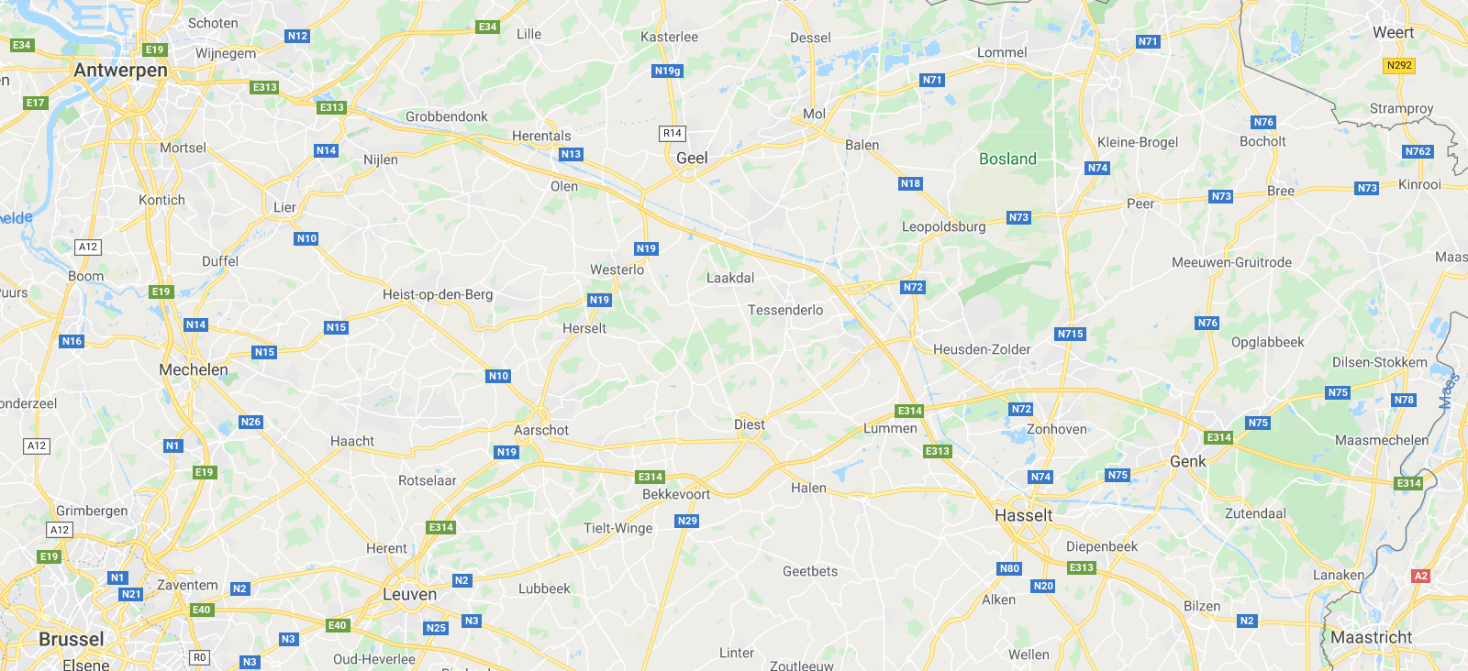
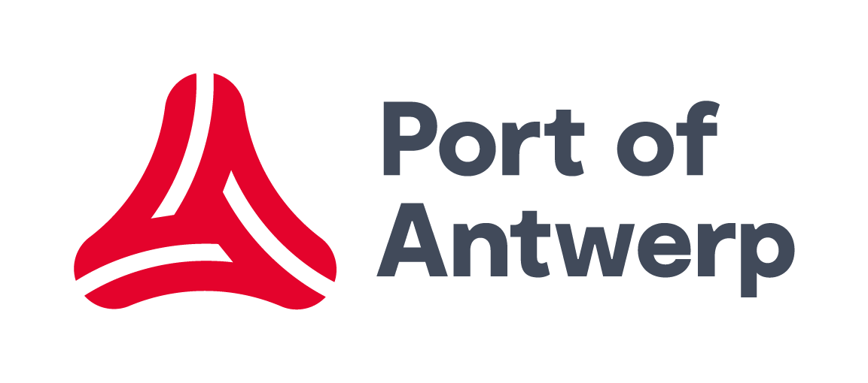
CASE
Full
Empty
COMPANY A

Slide 16
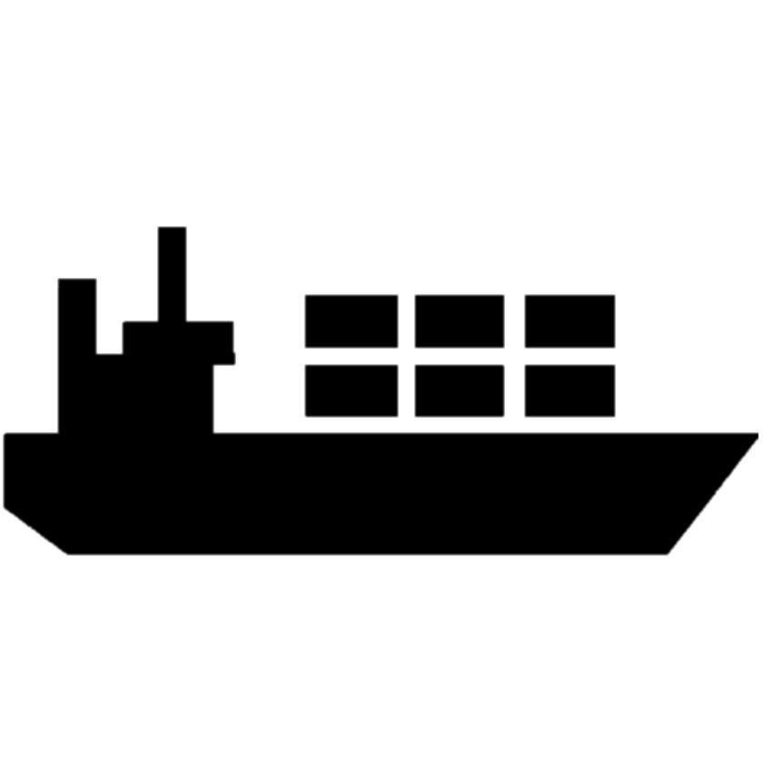

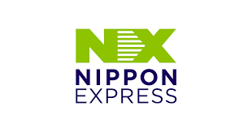
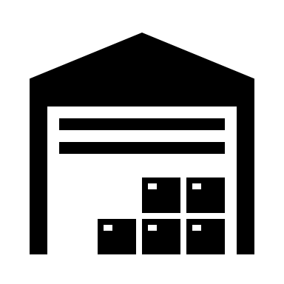
Develop the product
COMPANY A
X
X
X
POL
COMPANY B

Slide 17
Distance analyses
Emission Comparison
*CO2 expressed in kg
Haulage method | Truck | Inland shipping | Total distance
Road | 440 km | 0 km | 440 km
Intermodal (Round Trip) | 58 km | 400 km | 458 km
Container re-use | 58 km | 200 km | 258 km
Haulage method | Truck | Inland shipping | Transship-ments | Total
Road | 338,1 | 0 | 16 | 354,1
Intermodal (Round trip) | 41,8 | 68 | 64 | 173,8
Container re-use | 41,8 | 34 | 40 | 115,8
Container re-use results in:
67 % reduction compared to road haulage
33 % reduction compared to regular intermodal transport

Slide 18
Price analyses
Roundtrip road
Total cost | € A
Roundtrip intermodal
Total cost | € A-10%
Single trip Intermodal
Total cost | € A-22%
Single trip NX container re-use at Port of Limburg
Total cost | € A-30%

Slide 19
Nippon Express Group Corporate Message
We
Our unified strength makes us unique, driving everything we do on the frontline and in the background to deliver unparalleled logistics services. The word "we" speaks to a complex system of individuals with specialized skills that work together to become an unstoppable force.
Find
Every client, project, and task is different, and sometimes we have to innovate to achieve our goals. Our work demands exploration and thinking outside the box. It's how we find the best way. The verb "find" in its present form tells a story of a company willing to dig deeper for the best results.
the Way
Sure, there are many solutions, but there's only one best way. We don't find a way or some way; we find the best way, and we do it with passion and perseverance. Our efforts build connections to and between individuals and businesses.
Nippon Express Belgium NV/SA – Copyright 2022. All rights reserved

Slide 20
