Slide 1
PORT OF LIMBURG

Slide 2
In a nutshell
New inland port
Joint venture
Machiels & H.Essers
Genk, BE
at the Albert Canal
Specialized in containers
Operational by 2024
Extended gateway of the Port of Antwerp
Throughput capacity:
353.000 TEU/y
Total employment:
170 FTE’s
Important leverage towards local economy

Slide 3
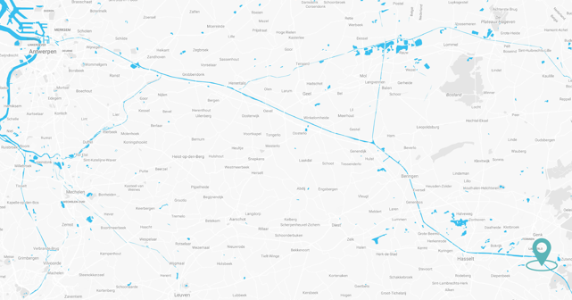
Location
Genk (BE), at the Albert Canal
Brownfield development: former Ford-site
Adjacent to logistics developments of H.Essers Dry Port and Genk Green Logistics
Unique location in the Euroregion with excellent connection to the Hinterland

Slide 4
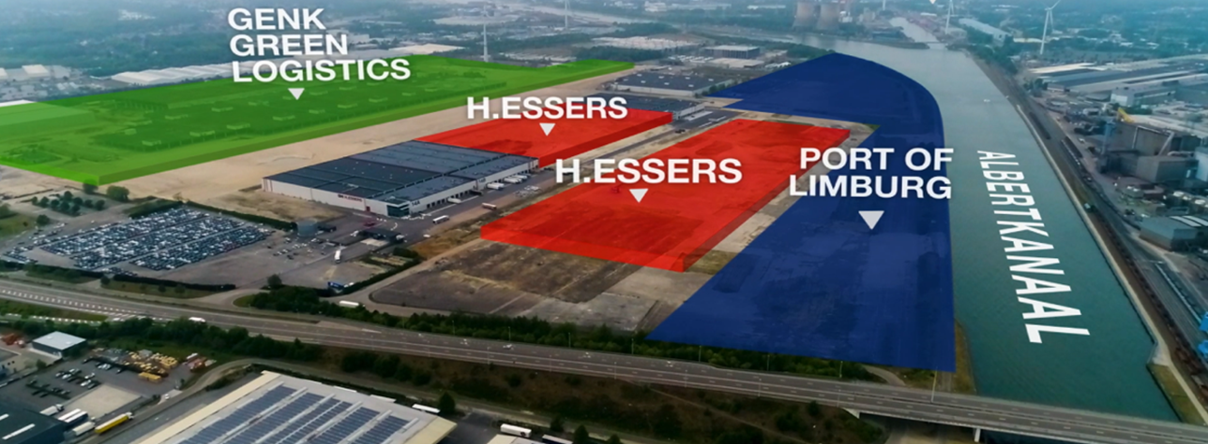
Location

Slide 5
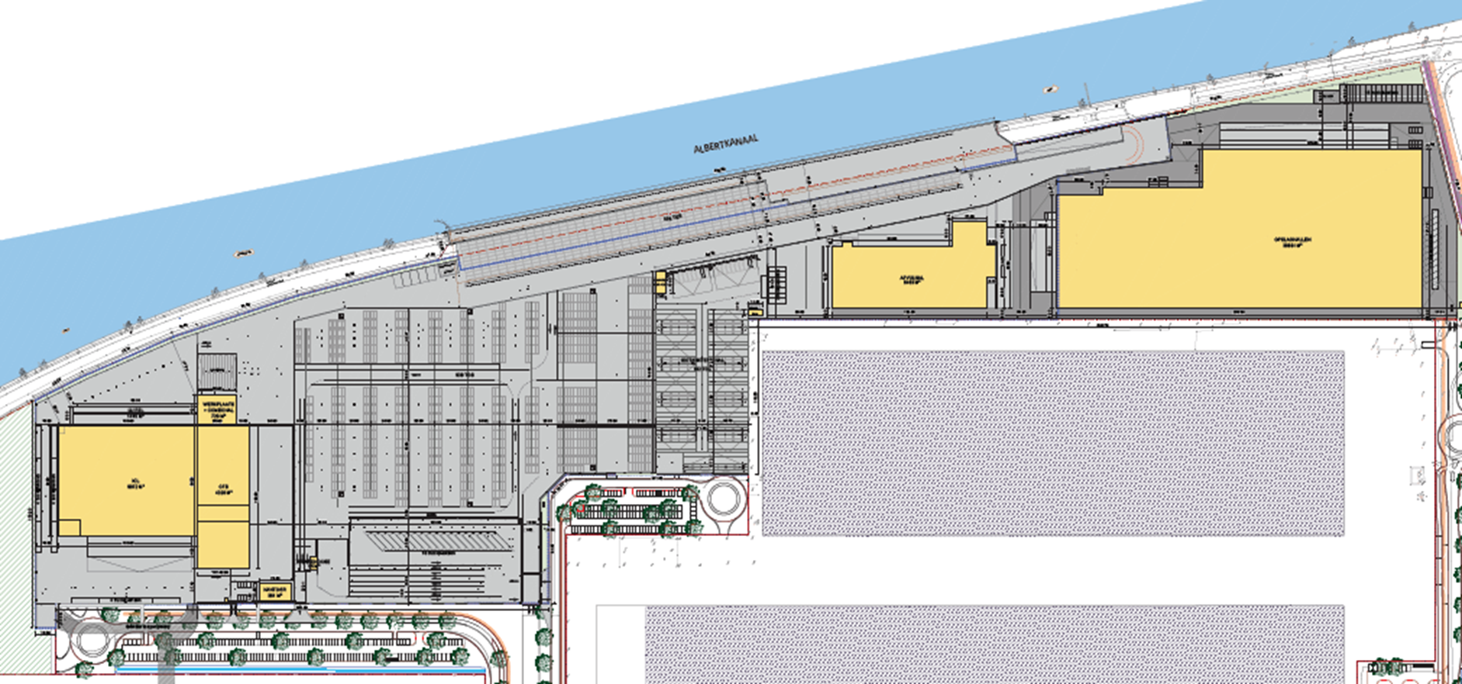
Masterplan
Port of Limburg

Slide 6
Services
Frequent connections to Antwerp & Rotterdam
Last & first mile transport via road
Stuffing & stripping
Container cleaning & repair
Gassing, degassing & gas measurements
VGM weighing
Additional focus on pharmaceuticals & chemicals:
  Reefer handling
  Iso tank yard with heating installation
  Filling lines for iso tanks
  Logistics activities

Slide 7
Timeline licensing & construction
Start groundworks by the Flemish Waterways
06/2021
Filing of Environmental License 11/2021
Filing of exploitations license
03/2022
Start quay by the Flemish Waterways
08/2021
Delivery quay
06/2022
Start building ICL
09/2022
Go-live ICL
07/2023
Go-live Terminal
2024

Slide 8
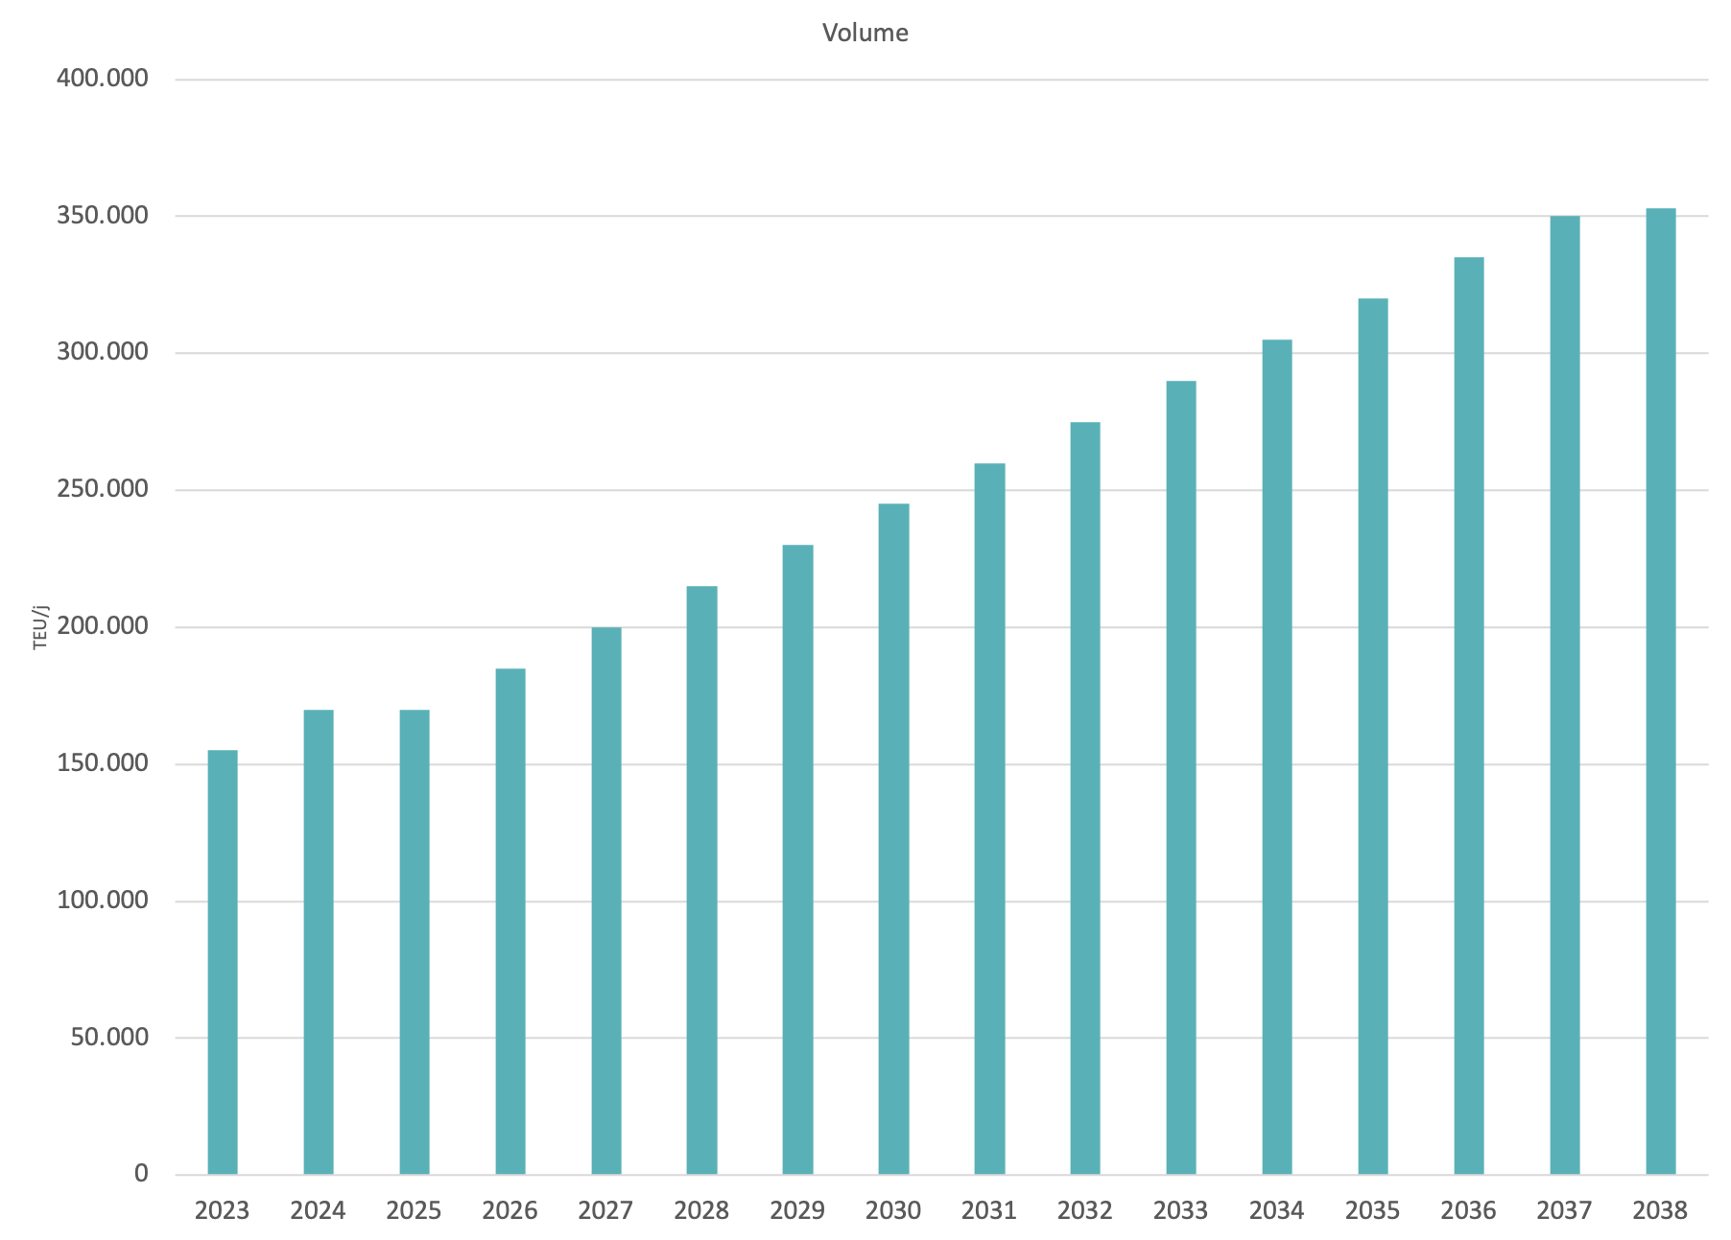
Capacity
Carve out of container business out of Haven Genk
Continuous growth of 15.000 TEU/y
Max capacity of 353.000 TEU

Slide 9

Sustainability
Environment
Employment
Innovation
Portoflimburg.eu | © Port of Limburg 2022. | 14 januari 2022

Slide 10
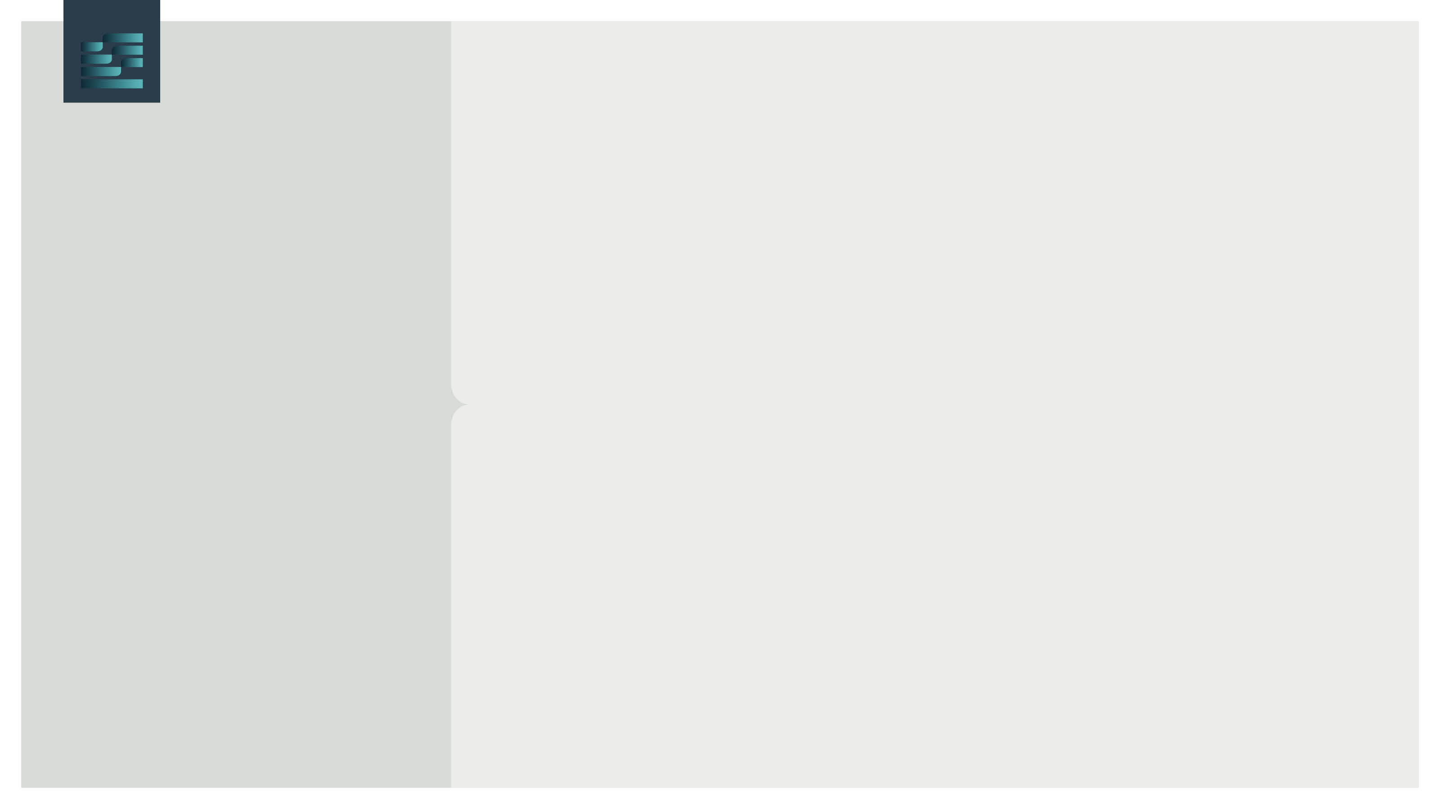
Sustainability
Answer to congestion of Antwerp road network
Facilitator and accelerator of
Modal shift
Brownfield development
Environment
Strengthening of
TEN-T network
Perfect fit with
Green Deal
Portoflimburg.eu | © Port of Limburg 2022. | 14 januari 2022

Slide 11
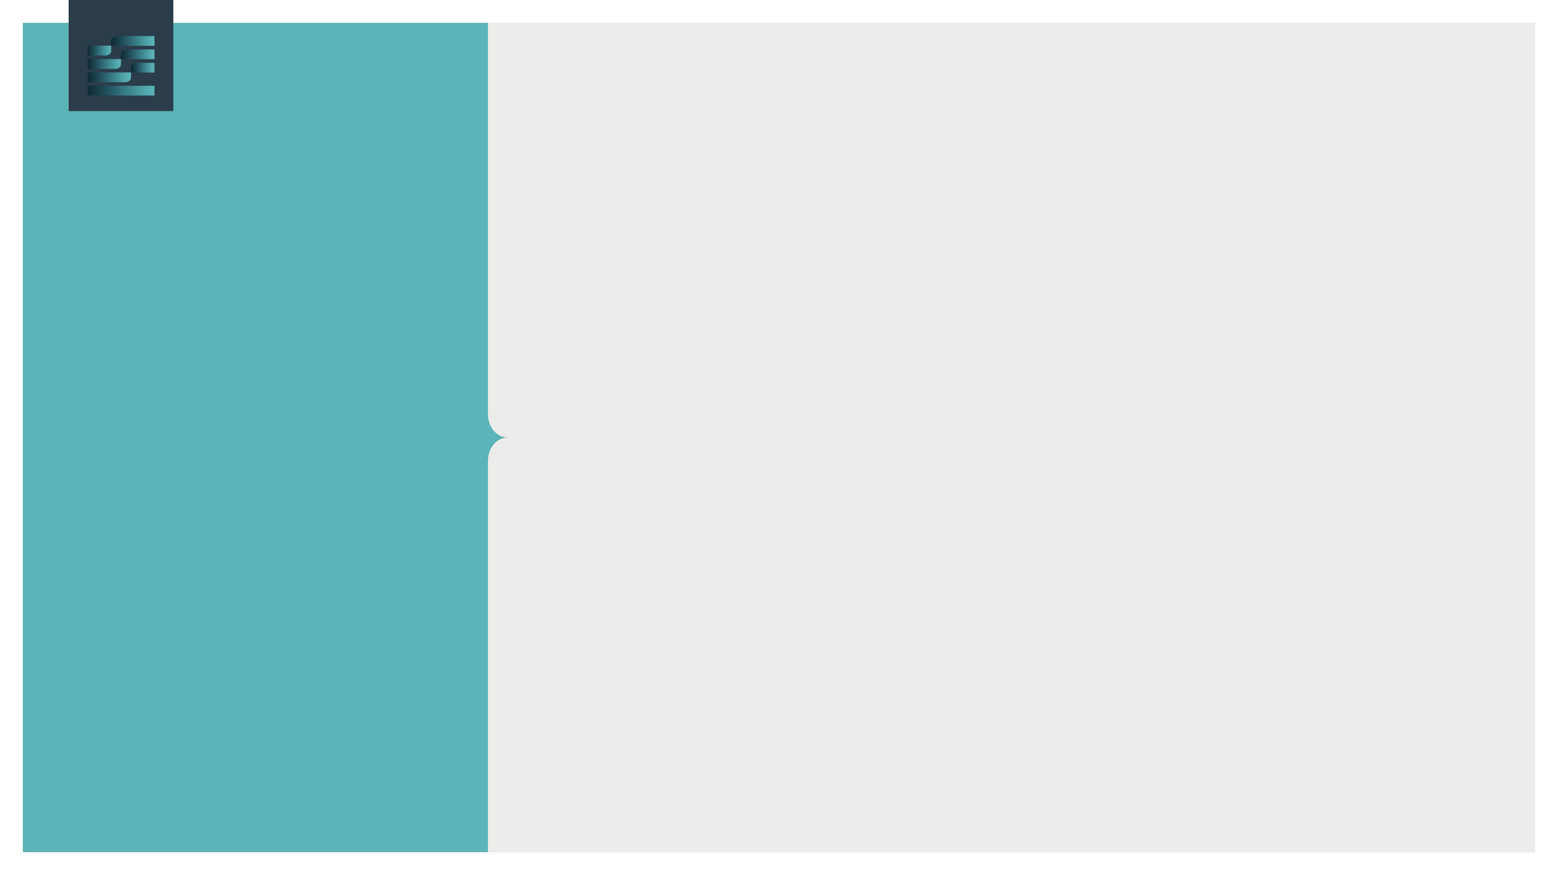
Sustainability
Direct employment: 170 FTE’s
Indirectly via growth inland waterway traction
and last & first mile road transport
Leverage for logistic activities in the direct neighbourhood
Employment
Portoflimburg.eu | © Port of Limburg 2022. | 14 januari 2022

Slide 12
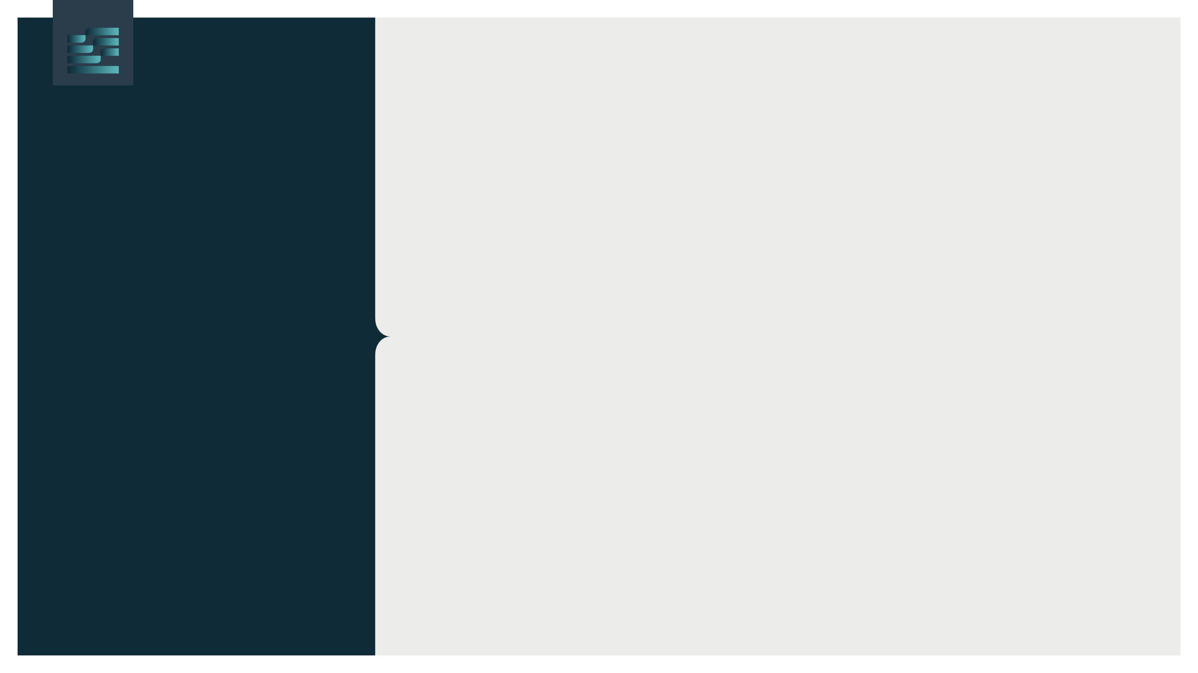
Sustainability
Specialised
container terminal
Broad range of value adding activities
Smart systems
Isotank terminal with heating installation
Filling installation
Cleaning installation
Innovation
Container repair
Automated gate
Portoflimburg.eu | © Port of Limburg 2022. | 14 januari 2022

Slide 13
Thank you!

Slide 14


