Slide 1
H.ESSERS
DRY PORT GENK

Slide 2
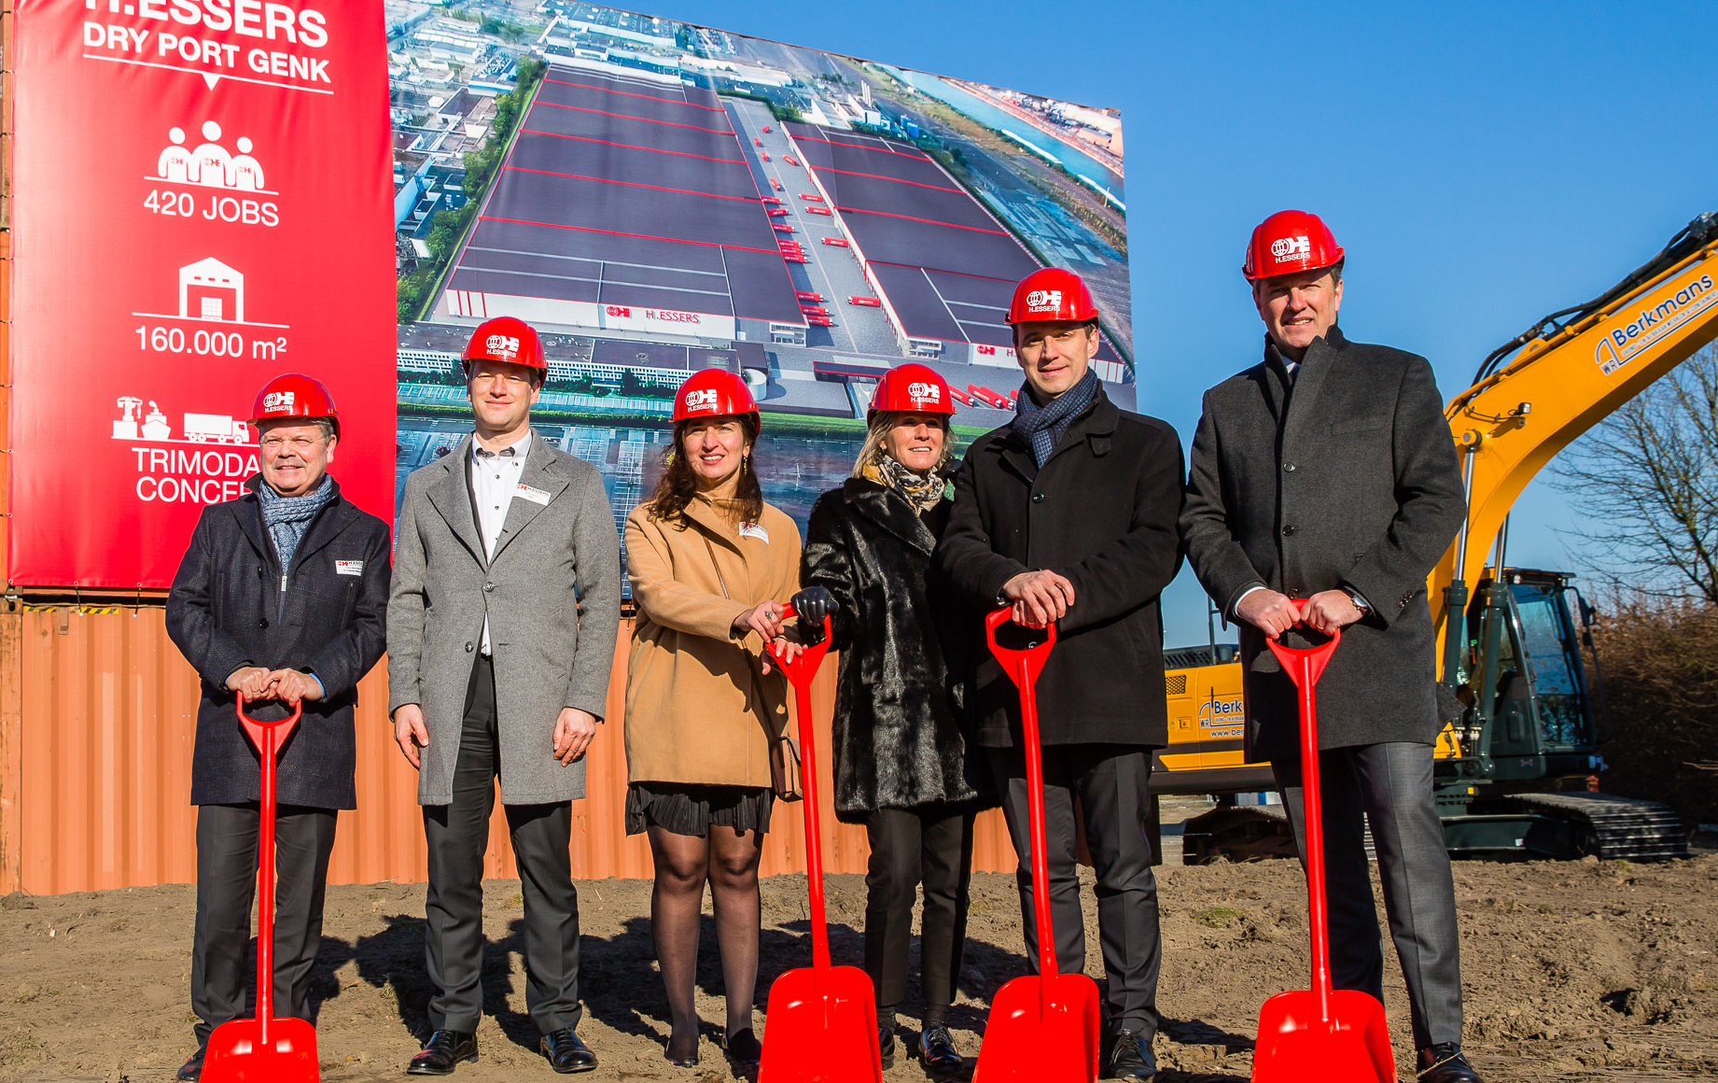
DRY PORT
The beginning
4 years ago… (February 2018)

Slide 3
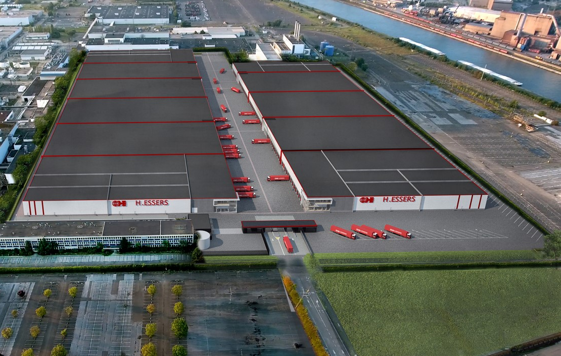
DRY PORT
PHAses
Phase 1: 14AB – Dec 2018
First customer: 15.000 pal
Phase 2: 14F – May 2020
Filling room & LF fridge
10.000 pal + VAS
5 different customers
Phase 3: 14CDE – Sep-Dec 2021
Extension for customer 14AB to 36.000 pallets
2 new big customers
Timeline buildings = on track
Go live 18/05 = OK
F
E
E
D
D
C
C
B
B
A
A
14
15
3

Slide 4
DRY PORT
PHAses
Phase 4: 15A – Expected Sep 2022
Extension existing customer: 15.000 pallets paint and spare parts
Phase 5: 15BC – Expected 2023-2024
Growth existing customer: 20.000 pallets coatings
Phase 6: 15DE – Expected 2025-2026
Growth existing customer: 22.000 pallets paint
Timeline buildings = on track
Go live 18/05 = OK
F
E
E
D
D
C
C
B
B
A
A
14
15
4

Slide 5
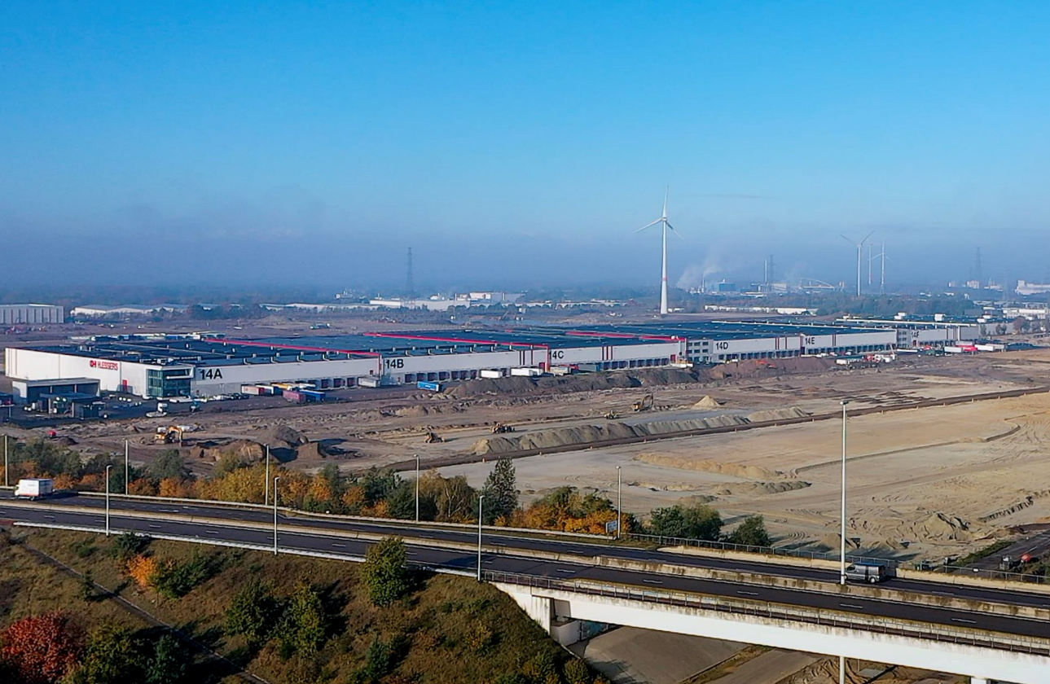
H.Essers Dryport
Key figures:
Pallets:
Paint & Coatings: 67.000 pallets
Chemicals/Labo: 36.000 pallets
Chemicals + spare parts: 30.000 pallets
Several special/VAS chemical customers: 10.000 pallets
Employees: 570 FTE’s

