Slide 1
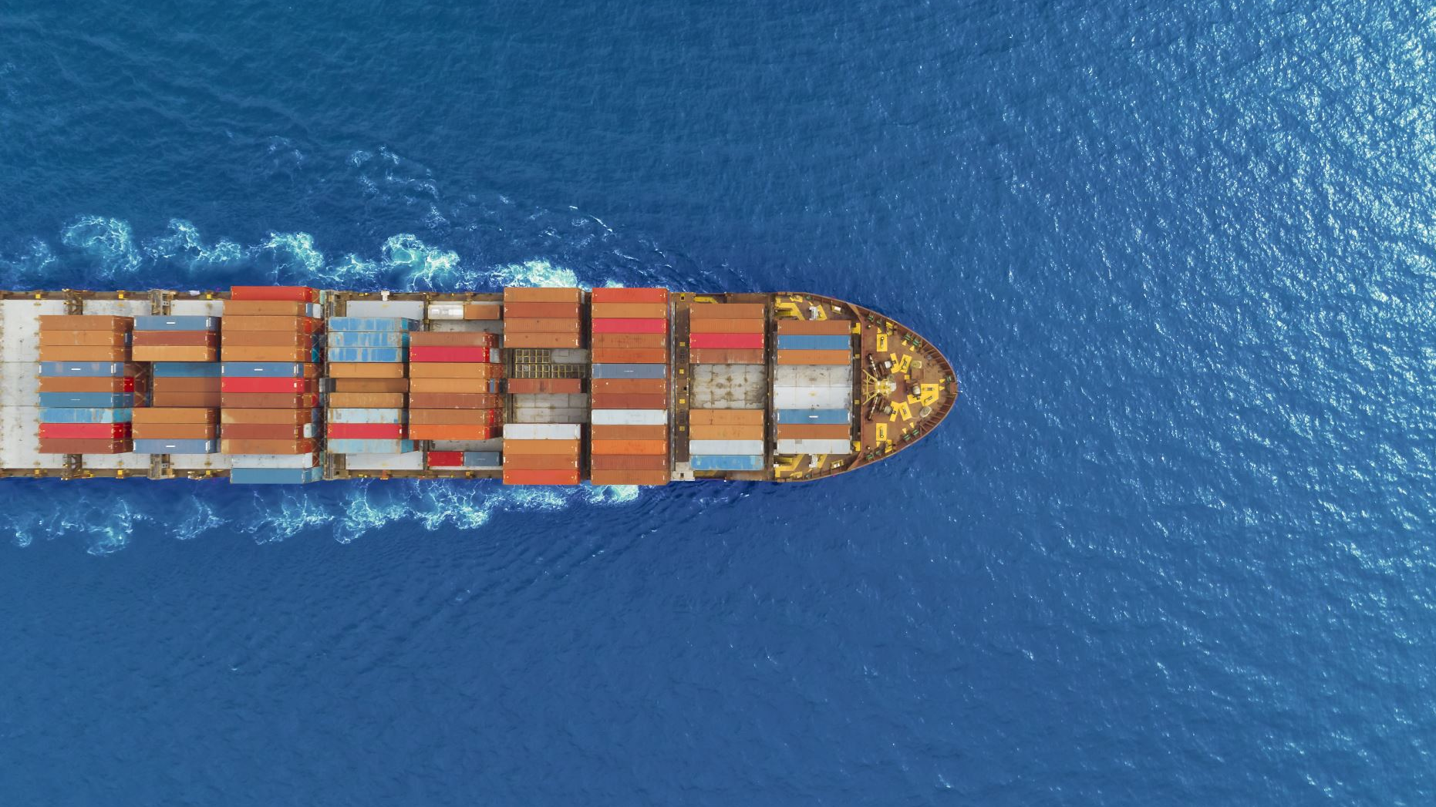
Logistics Valley Flanders
24/05/2022

Slide 2
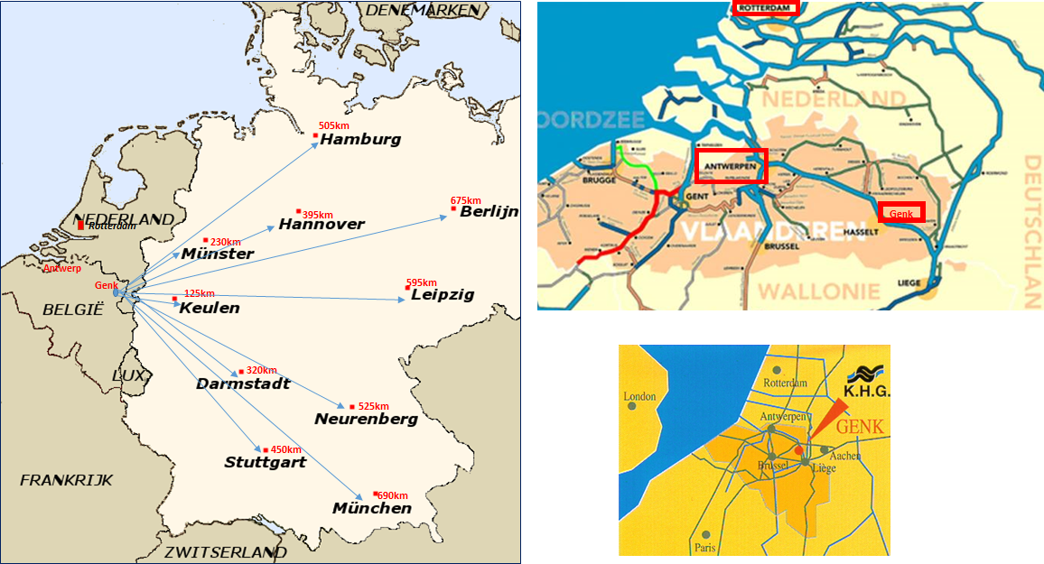
Location towards Seaports and Germany

Slide 3
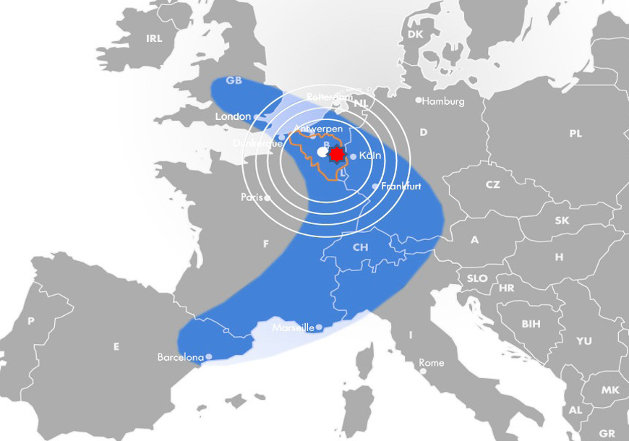
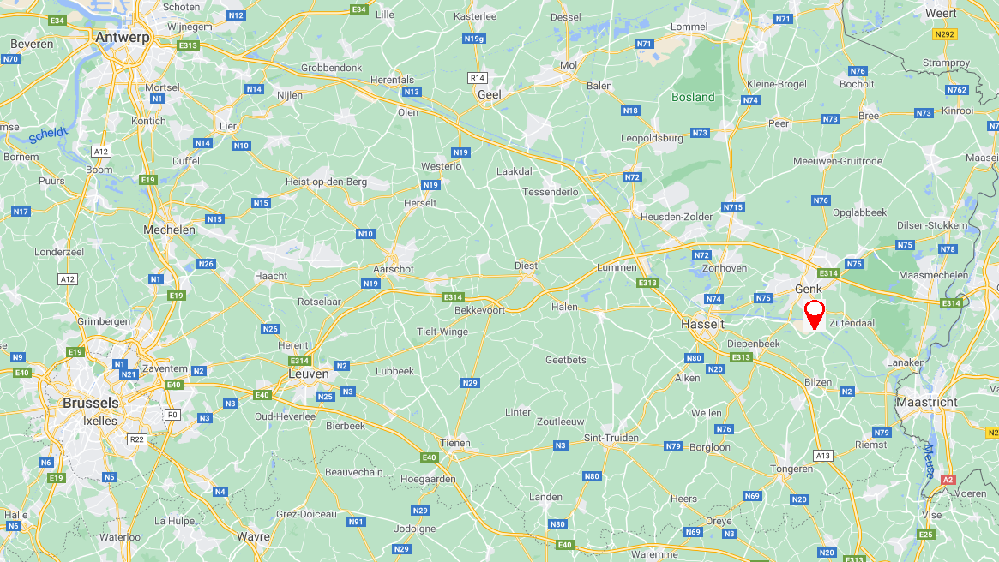
Central location
Genk, at the Albertkanaal
Two existing succesful rail terminals in Genk
Extended gateway Port of Antwerp
Unique location in the Euregio with excellent connection to the hinterland

Slide 4
Location
Haven Verbinding

Slide 5
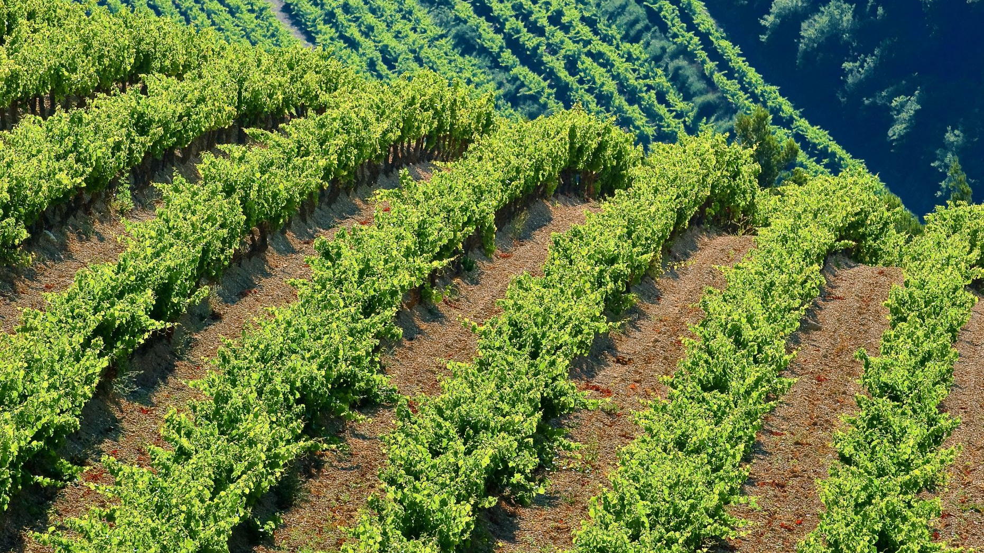
Genk Green logistics

Slide 6
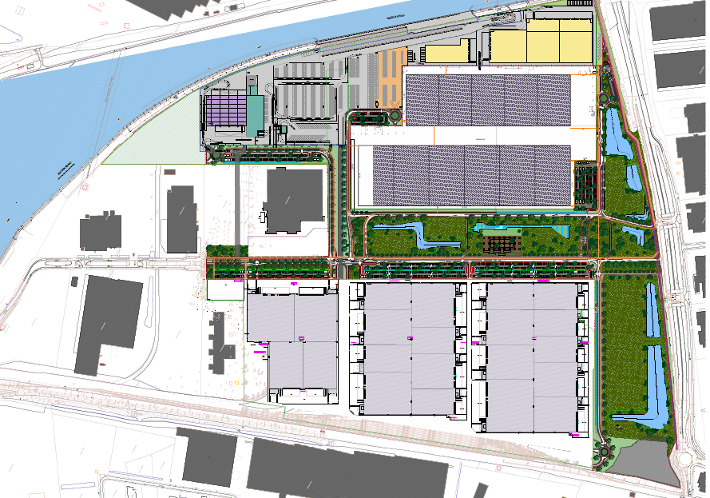
Site
GGL
Joint Venture
Group Machiels
Intervest Offices and Warehouses
Mondeo
Transit
Galaxy

Slide 7
Key assets
XXL site
Multimodality
Sustainability
Scalable
Existing Permits

Slide 8
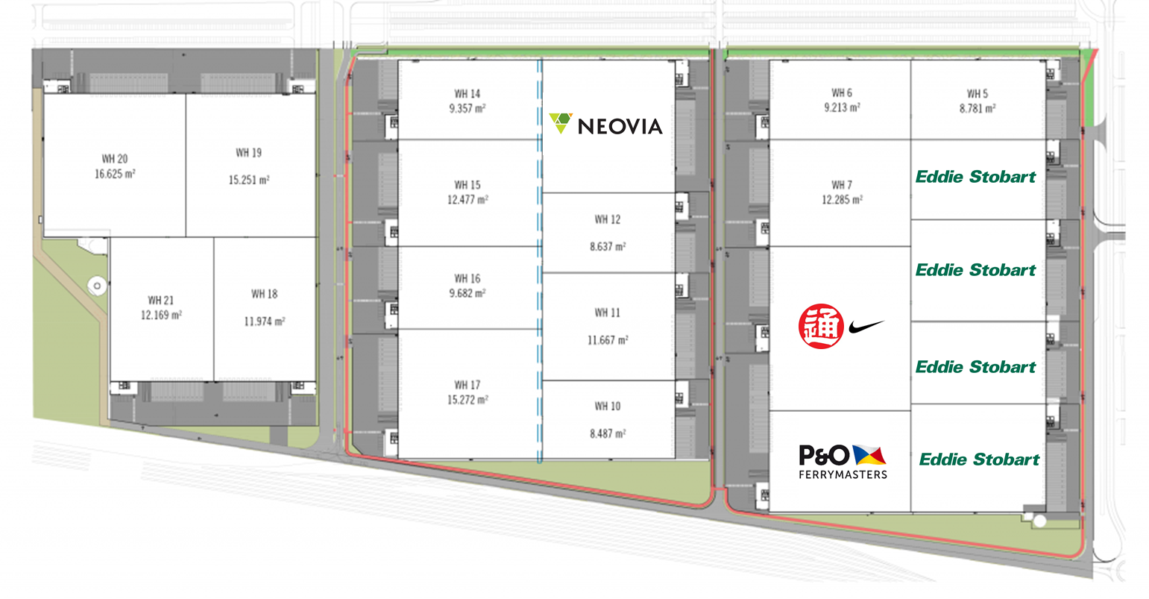
Joint venture between Group Machiels and intervest
Logistics Valley Flanders: G.G.L.
Optie
Optie
?
Optie
Optie
?
Optie
In Overleg
?
?

Slide 9
Einde

